Slide 1
CIS 4517/5517: Data Intensive and Cloud Computing Distributed file systems: HDFS
Dr. Xubin He
Computer and Information Sciences
Temple University

Slide 2
Previous class
GFS
Courtesy: Some slides are adopted and modified from J.F. Paris, Kennedy, C. Borcea and N. Venkatasubramanian, and the papers of GFS and HDFS.
.

Slide 3
GFS Architecture

Slide 4
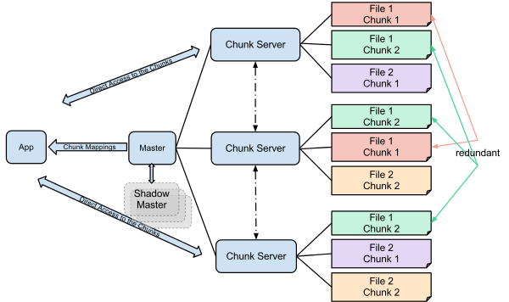

Slide 5
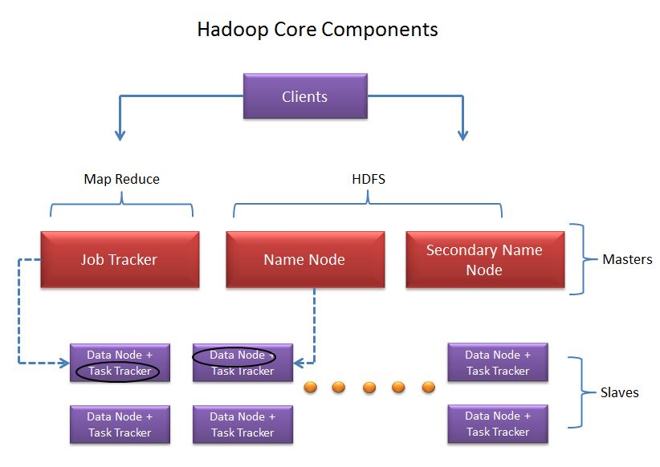
Hadoop Master-Slave Architecture
Source: http://saphanatutorial.com/hadoop-cluster-architecture-and-core-components/
Notes:
Secondary name node is not a backup, it seves as a house keeping.

Slide 6
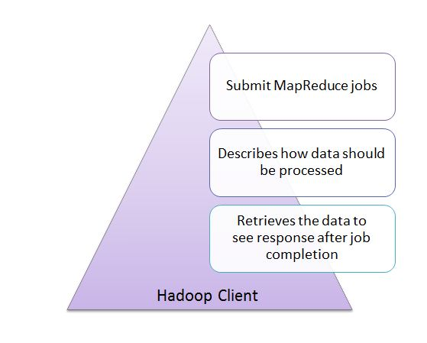
Clients
Source: http://saphanatutorial.com/hadoop-cluster-architecture-and-core-components/

Slide 7
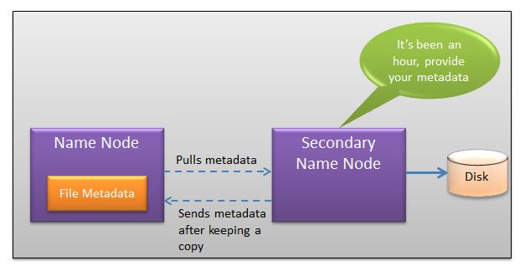
Namenode and secondary namenode
Source: http://saphanatutorial.com/hadoop-cluster-architecture-and-core-components/

Slide 8
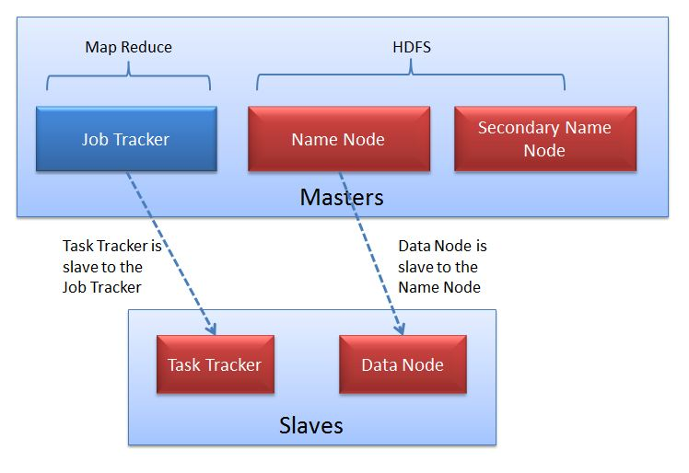
Slaves
Source: http://saphanatutorial.com/hadoop-cluster-architecture-and-core-components/

Slide 9
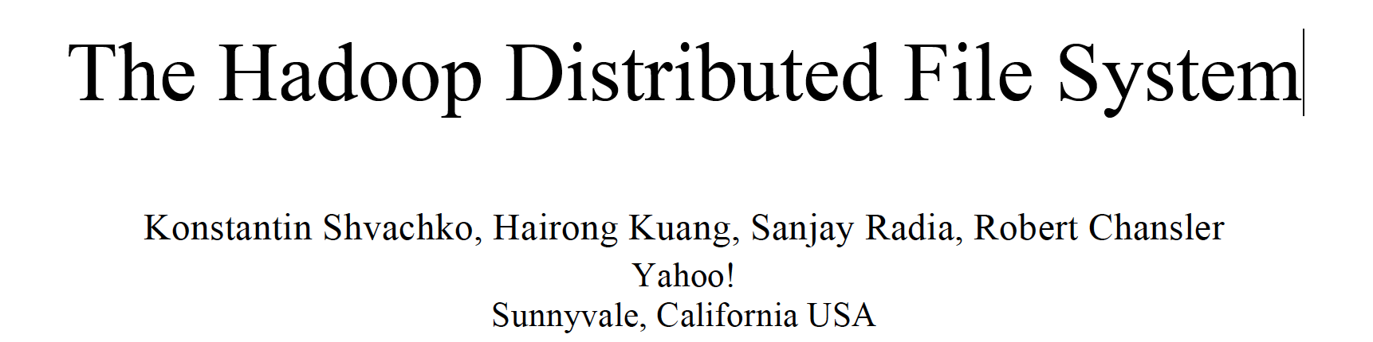
HDFS
The Hadoop Distributed File System (HDFS) is the file system component of Hadoop. It is designed to 1) reliably store very large data sets and to 2) deliver those data sets with high throughput to user applications, achieved by replicating file content on multiple machines (DataNodes).
Courtesy: Some of the following slides are adopted from:
https://cse.buffalo.edu/~okennedy/courses/cse704fa2012/2.2-HDFS.pptx

Slide 10

HDFS
Inspired by Google FS
Master/slave architecture
NameNode is master (meta-data operations, access control)
DataNodes are slaves

Slide 11
HDFS blocks
HDFS is a block-structured file system: Files are divided into blocks (or chunks) with a default size of 128MB.
A file may consist of many blocks, which are stored across a cluster of one or more machines.
Each block of a file is replicated across a number of machines (3 by default).

Slide 12
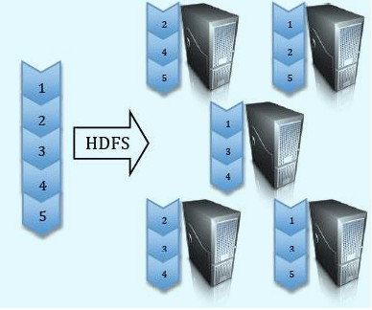
HDFS block replication

Slide 13
NameNode and DataNodes
HDFS stores file system metadata and application data separately.
Metadata refers to file metadata(attributes such as permissions, modification, access times, namespace and disk space quotas).
HDFS stores metadata on a dedicated server, called the NameNode (Master). Application data are stored on other servers called DataNodes (Slaves).
All servers are fully connected and communicate with each other.

Slide 14
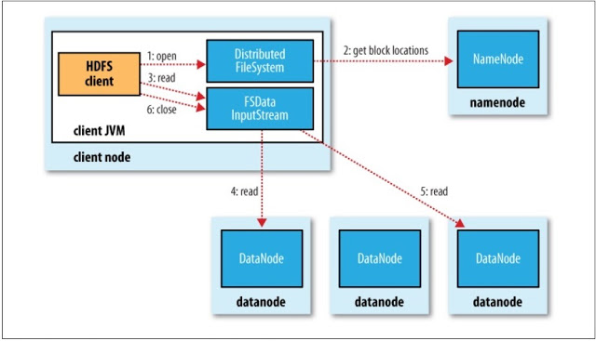
Reading data from HDFS
http://malsolo.com/blog4java/?p=516

Slide 15
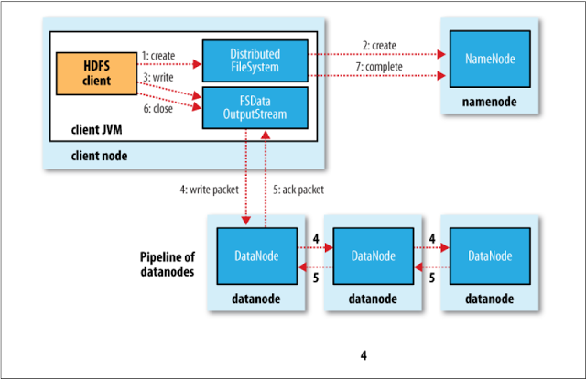
Writing data to HDFS
http://malsolo.com/blog4java/?p=516

Slide 16
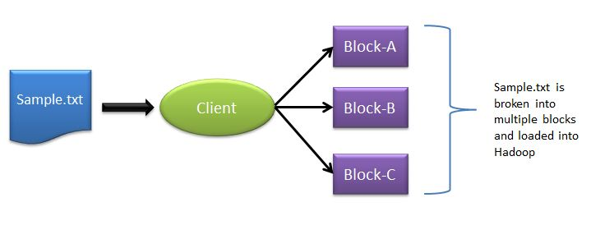
Typical workflow in HDFS
How is data loaded?
Source: http://saphanatutorial.com/hadoop-cluster-architecture-and-core-components/

Slide 17
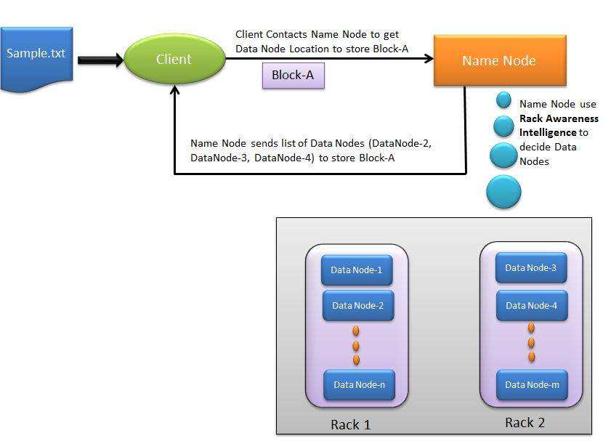
Typical workflow in HDFS
Where to load?
Source: http://saphanatutorial.com/hadoop-cluster-architecture-and-core-components/

Slide 18
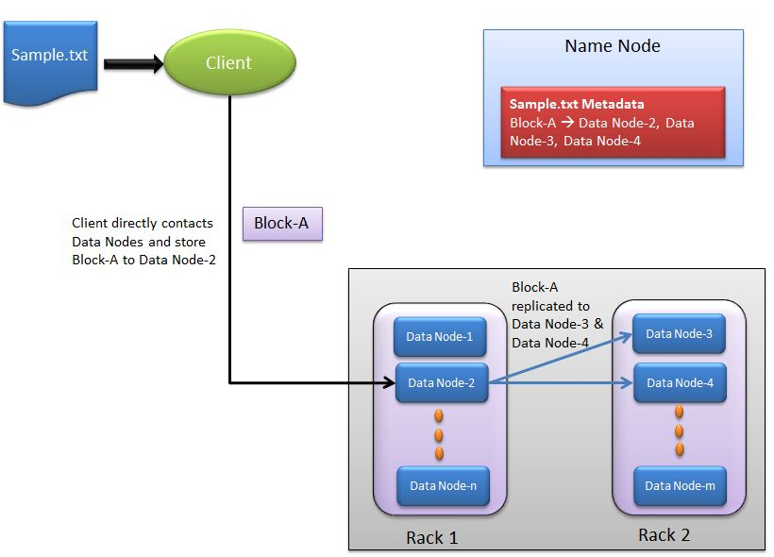
Typical workflow in HDFS
How to replicate?
Source: http://saphanatutorial.com/hadoop-cluster-architecture-and-core-components/

Slide 19
Distributed System: Problems
“You know you have a distributed system when the crash of a computer you’ve never heard of stops you from getting any work done.” –Leslie Lamport
Distributed systems must be designed with the expectation of failures.

Slide 20
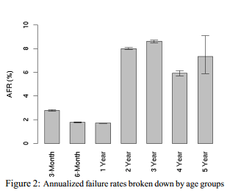
Failures
In large data centers, the Annualized Failure Rates (AFRs) of disk drives are more than 3%.
The observed disk AFRs range from from 1.1% to as high as 25%, which are by a factor of up to 30 higher than the datasheet AFRs. [BSchroeder and Gibson]
Concurrent failures are not rare. 37% failures are concurrent. [Ford et al, OSDI’10]
Source: Pinheiro et al, “Failure Trends in a Large Disk Drive Population“, FAST’07

Slide 21
How to detect failures?
NameNode and DataNode: Heartbeats.
Every DataNode sends heartbeats to the NameNode periodically to confirm that the DataNode is functional.
“I am alive.”

Slide 22
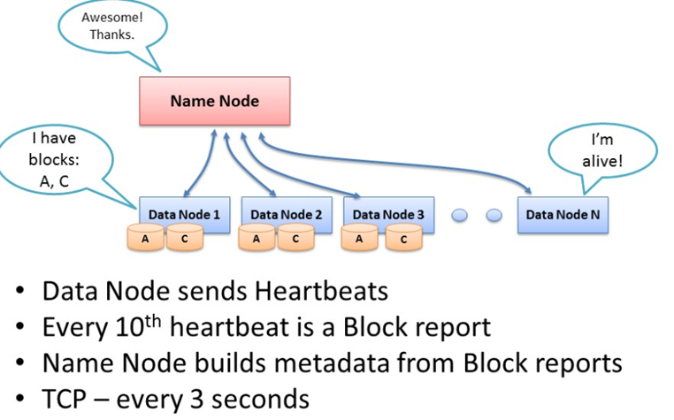
Heartbeats

Slide 23
Block reports
A DataNode identifies block replicas in its possession to the NameNode by sending a block report. A block report contains the block id, the generation stamp and the length for each block replica the server hosts.
Block reports provide the NameNode with an up-to-date view of where block replicas are located on the cluster and nameNode constructs and maintains latest metadata from block reports.

Slide 24
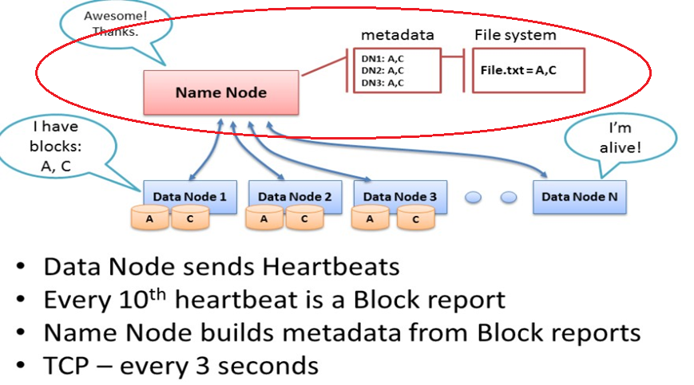
Metadata update

Slide 25
Failure Recovery
. The NameNode does not directly call DataNodes. It uses replies to heartbeats to send instructions to the DataNodes. The instructions include commands to:
Replicate blocks to other nodes:
DataNode died.
copy data to local.
Remove local block replicas;
Re-register or to shut down the node;

Slide 26
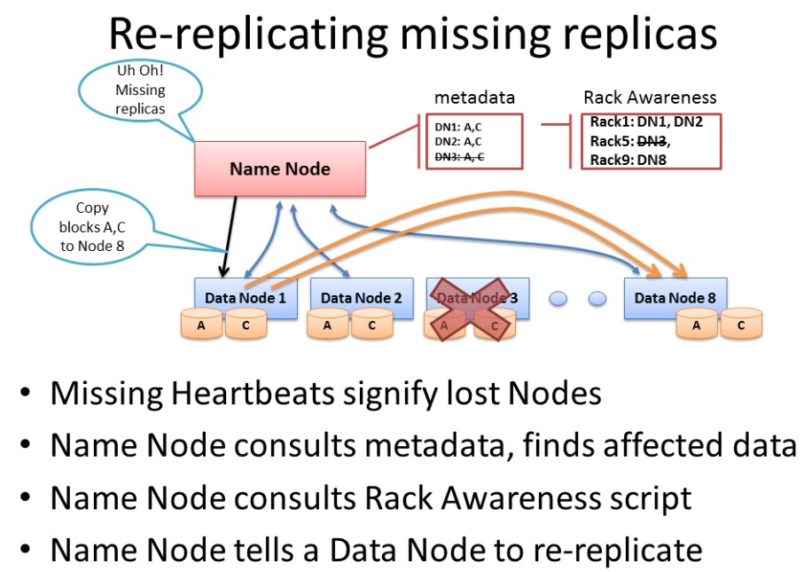
Re-replicating blocks

Slide 27
Failure recovery
When a dataNode dies, NameNode will notice and instruct other dataNode to replicate data to new dataNode.
How about if the NameNode dies?

Slide 28
Name node failure
Journaling/checkpointing
Multiple namenodes (backup namenodes)

Slide 29
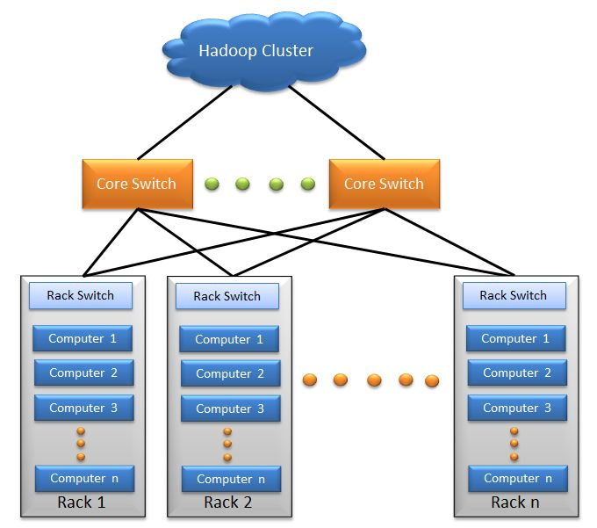
Hadoop Cluster
Source: http://saphanatutorial.com/hadoop-cluster-architecture-and-core-components/

Slide 30
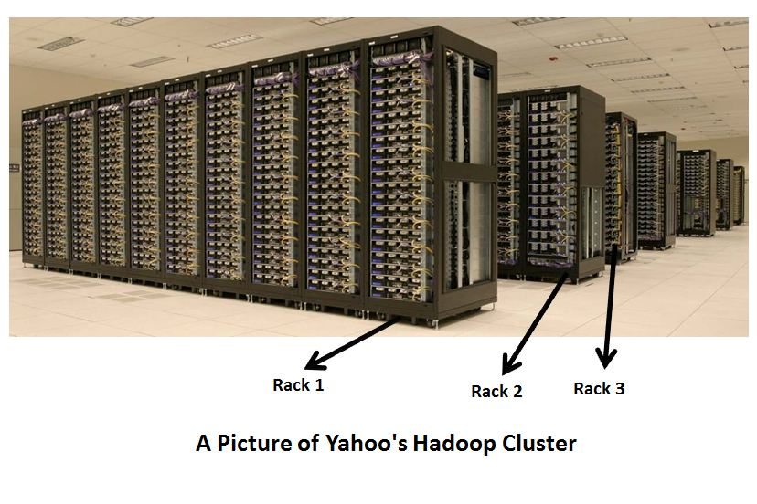
A real Hadoop cluster
Source: http://saphanatutorial.com/hadoop-cluster-architecture-and-core-components/

Slide 31
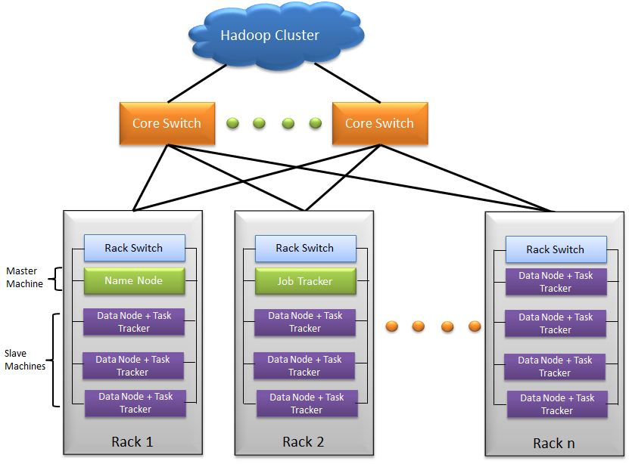
Hadoop cluster architecture
Source: http://saphanatutorial.com/hadoop-cluster-architecture-and-core-components/

Slide 32
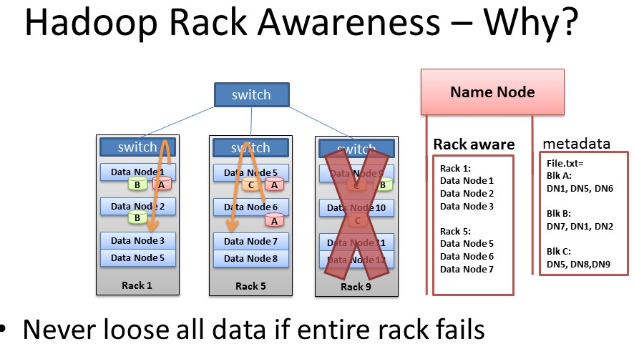
Erasure coding vs replication?
A topic we will discuss later in cloud storage.

Slide 33
Installation
Hadoop supports Linux and Windows
Easy to install and set up on Linux
Windows supported well in Hadoop 2 and after
Can use virtual machine to run locally
Requires several pieces of software
Java 1.6 and above
ssh/sshd
Cygwin (for Windows shell support)

Slide 34
Installation on EC2
Create a cluster
Using prebuilt or custom AMI
Distribute Hadoop to the cluster
Similar to single node setup, but for each node in the cluster
Configure Master node(s) for NameNode, Secondary NameNode and ResourceManager
Configure Slave node(s) for NodeManager and DataNode
A step by step guide is posted in the course canvas.

Slide 35
Distributing Hadoop to EC2 cluster
If using a custom AMI, have Hadoop preloaded
Distribute common configuration files instead
Create configuration locally and use scp to push to each instance
If using a public AMI without Hadoop, distribute entire Hadoop install
Include configuration in scp-based push
Bandwidth expensive and inefficient
http://hadoop.apache.org/docs/r2.7.3/hadoop-project-dist/hadoop-common/ClusterSetup.html

Slide 36
A video on Hadoop
Demystifying Hadoop, ~22 minutes

Slide 37
Try these offline:
Configure Hadoop on AWS
Remember to stop Hadoop and your instances when you are finished
Use EBS or S3 to save your persistent changes
Don’t forget to make local copies of debugging results
Documentation
Hadoop control commands

Slide 38
Useful links
Apache Hadoop: http://hadoop.apache.org/
MapReduce Tutorial
Analyzing bigdata with Amazon EMR
If you have problem with the instruction on setting up single-node cluster use the following link:
http://hadoop.apache.org/docs/r2.7.3/hadoop-project-dist/hadoop-common/SingleCluster.html#Pseudo-Distributed_Operation
If you have problem with configuring a multi-cluster setup, follow:
http://pingax.com/install-apache-hadoop-ubuntu-cluster-setup/
http://hadoop.apache.org/docs/r2.7.3/hadoop-project-dist/hadoop-common/ClusterSetup.html
If you are not confident enough to try setting Hadoop on AWS, then first try on your local machine
User VirtualBox (for Windows or Mac) or KVM (for Linux) with Ubuntu image to create VM and try setting up Hadoop in the VM(s)

Slide 39
References
The original paper on HDFS published in the IEEE MSST conference [2010]
https://storageconference.us/2010/Papers/MSST/Shvachko.pdf
The original paper on Google File System published in SOSP conference [2003]
https://static.googleusercontent.com/media/research.google.com/en//archive/gfs-sosp2003.pdf
A presentation on HDFS:
https://cse.buffalo.edu/~okennedy/courses/cse704fa2012/2.2-HDFS.pptx
Hadoop and HDFS:
https://hadoop.apache.org/docs/current/hadoop-project-dist/hadoop-hdfs/HdfsDesign.html
Introduction to HDFS:
https://www.ibm.com/developerworks/library/wa-introhdfs/index.html
MapReduce: Simplified Data Processing on Large Clusters, OSDI’2014
https://research.google.com/archive/mapreduce-osdi04.pdf

